Slide 1
Clean Architechture
Be clean...Adopt it
Shamik Mitra
10 years of experience in Java/j2ee
Former IBMer,Work in CTS
Technical Archirect
MVB on Dzone
DZone Integration Magazine 2016 on of the Author.
Techathon winner
mitrashamik@gmail.com

Slide 2




Messy Architechture
Tightly Coupled

Slide 3
Demerits of tightly coupled Architechture
Rigidity: Not accept Future changes easily.
Fragile: change in a functionlity breaks other Module
Ripple Effect : change requires for multiple area to incorporate/update a function
Not Scalable : Not able to adopt future technology.

Slide 4
Differnet Objects
Input Objects : Take input from user or another layer. Think as an request Object(Command pattern)
Business Objects : use for business computation(Business specific/Domain Objects/Entity)
Output Object : Provide Computation result to user or another Layer.

Slide 5
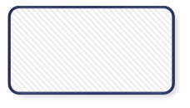
Clean Architechture
Layerd Achitechture/Entity-Control-Boundary

Slide 6
Clean Architechture Tips
Use Enity-Controller-Boundary pattern fro each Layer.
Demacrate Boundary very well.
Use Third party framework/library as a plugin
Don't make Thirdparty frame work Spouse treat as a Lover.
Think about TDD Test Driven Developement.
Ability to plug Mock Object if not Change code.
Refactor Refactor Refactor.. make it as habbit.

Slide 7

Design Tools
Efficient use of design tools Sharpen your architechture and
Your coding capability

Slide 8
SOLID Principal
Not SOLID state .... spell as S.O.L.I.D
Single responsibility Principle
Open/closed Principle
Liskov Substitution Principle
Interface Segrigation principle
Dependency Injection

Slide 9

Single Responsibility

Slide 10
SRP
Each Class/function has one reason to change.
Refactor

Slide 11
Open/Closed Principle
Open for Extension closed for Modification
OxyMoron: Without altering somethnig ,change it's Characteristics
Polymorphism: Has strength to change behaviour at runtime
Highlevel class only knows about interface nothing about implementation so possible to change behaviour at runtime with different implementations.

Slide 12
Example
public void getArea(String type,int length,int breadth)
  {
    if("square".equalsIgnoreCase(type))
    {
    calculateSquareArea(length);
    }
  else if("rectangle".equalsIgnoreCase(type))
  {
    calculateRectangleArea(length,breadth);
  }
  else if(type.equalsIgnoreCase(“circle”))
  {
    calculateCircleArea(length,breadth);
  }
  }

Slide 13
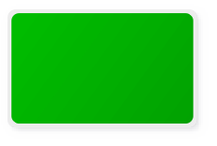
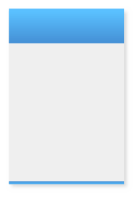
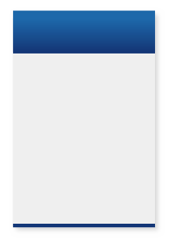
Solution
Shape Interface

Slide 14
Liskov Substitute Principle
If f(x)= y then f(x1)=y where x1 is subclass of x
According to OOPs
X.method(param)=Y then X1.method(param)=Y
Base class can be replaced by Subclass without breaking result or funtionality.

Slide 15
Problem
Square is-a Rectangle.
Rectangle area calculation length*breadth
Square area calculation side*side
Suppose implementation of Recangle
area(int length,bredth).
For Square we did
area(int length,int length); ignoring breadth. Break LSP. Say lenghth =5 breadth=4 so expected 20 outcome 25

Slide 16
Interface Segregation
Special kind of SRP
Not forcing implementing class to implement a funtionality which it is not made for.
Interface has many reason to change
FAT interface
HTTPServlets get and put method
Should be HTTPGetServlet and HTTPPutServlet

Slide 17
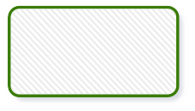
Problem

Slide 18
Solution

Slide 19
Dependency Injection
Flow Downwards

Slide 20
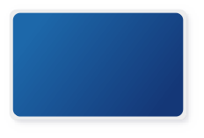
Solution
HLC and LLC
depeneds on
Interface

Slide 21
Thank You
Shamik Mitra
FaceBook : https://www.facebook.com/shamik.mitra.37
Blog : javaonfly.blogspot.in
Online Tutoring.
Dzone : https://dzone.com/users/1211805/mitrashamik.html

